Slide 1

5G Network DDoS Detection & Defense System
A Cybersecurity Approach using Machine Learning
PRESENTED BY:
Manav Shah - N227
Manav Goyal - N223
Meet Shah - N235

Slide 2

Introduction
🌐 Why This Matters in Cybersecurity
The evolution of 5G networks has enabled:
Massive device connectivity (IoT, smart systems)
Ultra-low latency communication
High-speed data transmission
However, this advancement introduces critical security challenges:
Larger attack surface
Increased network exposure
Difficulty in monitoring high-volume traffic
🚨 DDoS Attacks in 5G Networks
Attackers exploit high bandwidth to:
Flood servers with massive traffic
Exhaust network resources
Disrupt critical services
Impact:
Service downtime
Financial loss
Security breaches

Slide 3
Problem Statement
Security Problem
The rapid expansion of 5G networks has significantly increased data speed and connectivity, but it has also introduced new cybersecurity challenges. Traditional security systems struggle to detect modern threats such as Distributed Denial of Service (DDoS) attacks, which exploit high-speed infrastructure to overwhelm systems with massive traffic.
Most existing Intrusion Detection Systems (IDS) rely on signature-based techniques, making them ineffective against unknown or evolving attacks.
Although machine learning solutions exist, many report unrealistically high accuracy (near 100%), often due to data leakage, where models unintentionally learn hidden or time-based patterns instead of real attack behavior.
Core Problem
Develop a reliable and secure DDoS detection system that:
Avoids misleading results caused by data leakage
Accurately detects attacks in real-world scenarios
Provides trustworthy performance for deployment

Slide 4
Objectives & Goals
Project Objectives
Develop an intelligent ML-based system for detecting DDoS attacks in 5G networks
Accurately classify traffic as benign or malicious
Eliminate data leakage to ensure realistic model learning
Implement and compare multiple ML models
Apply cross-validation for reliable evaluation
Build an interactive dashboard for monitoring and simulation
Final Goal
Bridge the gap between machine learning theory and real-world cybersecurity applications

Slide 5
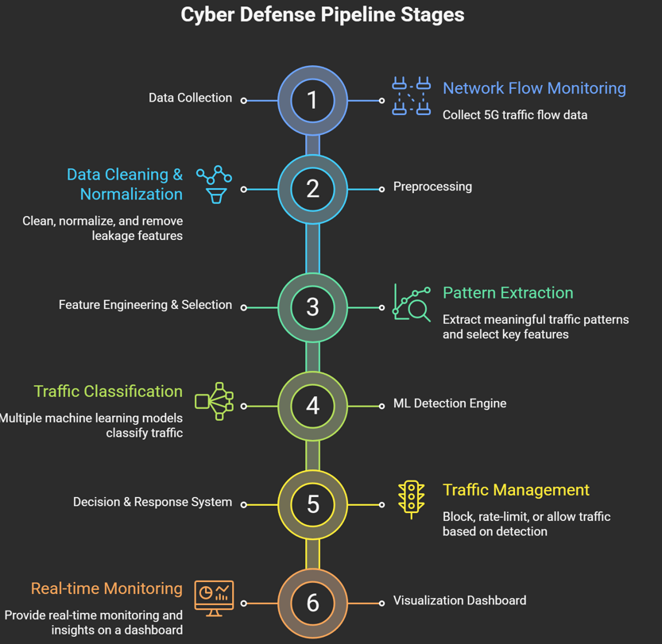
System Architecture
Cyber Defense Pipeline
Data Collection
Network flow data from 5G traffic
Preprocessing
Data cleaning, normalization
Removal of leakage features
Feature Engineering & Selection
Extract meaningful traffic patterns
ML Detection Engine
Multiple models classify traffic
Decision & Response System
Block / Rate-limit / Allow traffic
Visualization Dashboard
Real-time monitoring and insights

Slide 6
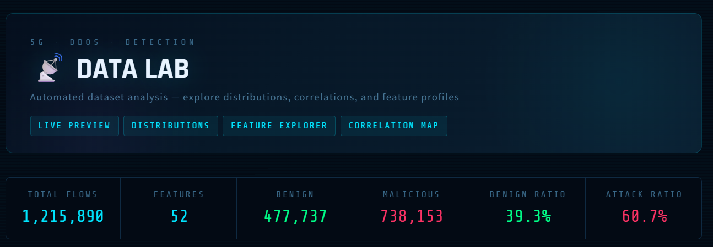
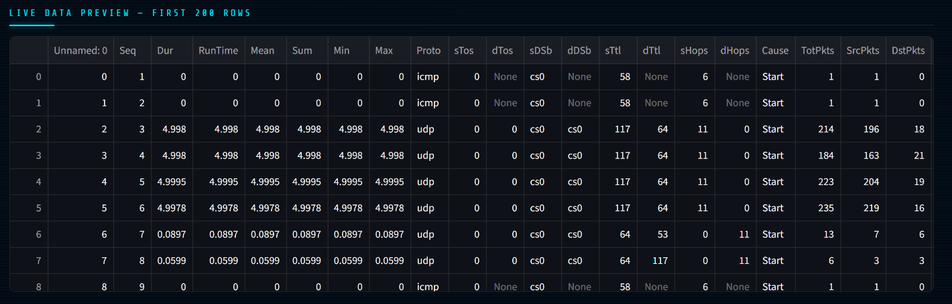
Dataset & Security Features
Dataset: 5G Network Intrusion Detection Dataset
Size: ~1.2 million records
50+ network traffic features
Feature Types
Packet-based features
Flow-based features
Time-based features
Traffic behavior metrics
Critical Issue Identified
Leakage features present:
Seq, RunTime, Offset, Dur

Slide 7
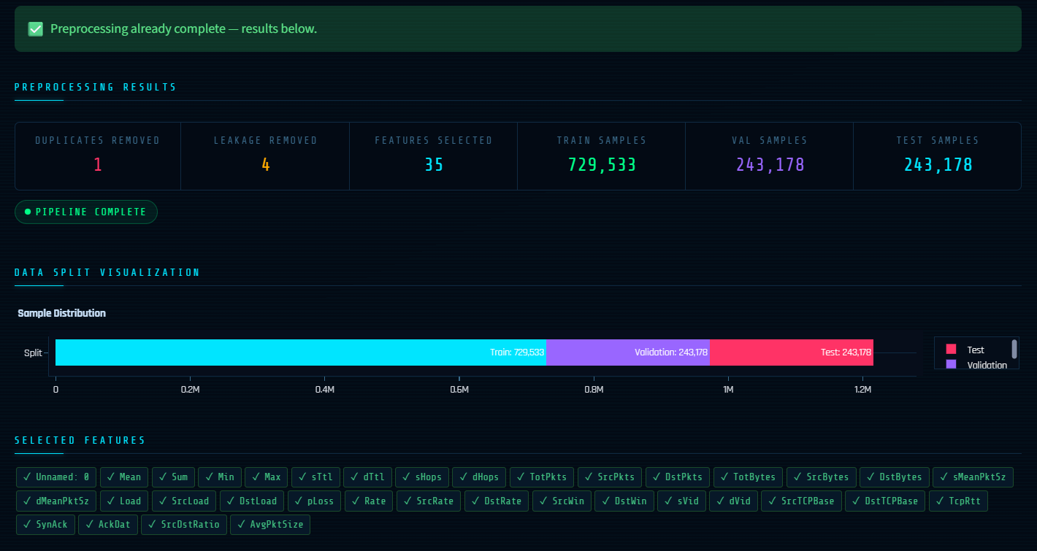
Data Preprocessing
Data Cleaning
Removed duplicates
Handled missing and infinite values
Leakage Removal (Key Innovation)
Removed: Seq, RunTime, Offset, Dur
Prevented models from learning false patterns
Feature Engineering
Created meaningful features:
Packet Rate
Source/Destination Ratio
Average Packet Size

Slide 8

ML-Based Threat Detection
Top Model Performance
Best Model: Gradient Boosting
Accuracy: 95.79%
F1-Score: 0.9577
CV Score: 0.9581
CV Stability: ±0.0002
Model Comparison Insights
Gradient Boosting, XGBoost, and LightGBM delivered top-tier performance (~95–96%)
Decision Tree also performed competitively with strong interpretability
Random Forest and Neural Networks showed slightly lower but stable results
Logistic Regression underperformed due to inability to capture complex patterns

Slide 9
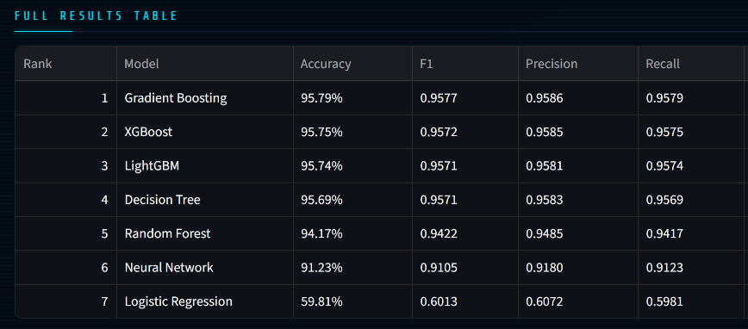

ML-Based Threat Detection
Multiple models used:
Logistic Regression
Decision Tree
Random Forest
Gradient Boosting
Neural Network
XGBoost
LightGBM

Slide 10
Real-Time Threat Monitoring
& Defense Simulation
Functional Components
1. Live Defense Simulation
Simulates real-time packet flow within a 5G network
Continuously scans and classifies incoming traffic
2. Machine Learning Model Integration
Detection powered by Gradient Boosting
Provides fast and interpretable predictions
Achieves:
Accuracy: 95.69%
F1-Score: 0.9571
3. Packet Inspection Module
Displays packet-level details including:
Traffic type (Benign / Malicious)
Prediction confidence score
System action taken
Automated Defense Mechanism
Block Action: Triggered when confidence ≥ 95%
Rate Limiting: Applied when confidence ≥ 85%
Alert System: Flags suspicious but uncertain traffic
Ensures low latency response and network stability

Slide 11
Real-Time Threat Monitoring
& Defense Simulation
The interface represents the Packet Inspection and Live Defense Monitoring module of the 5G DDoS Detection System. It combines real-time traffic analysis with machine learning-based threat detection to ensure proactive network security.
Live Defense Simulation
Simulates real-time network traffic flow and response.
Uses trained ML model to classify packets instantly
Performance Metrics:
F1-Score: 0.9577
Accuracy: 95.79%
Packets Scanned: 28 / 300
Packet Inspection Module
Utilizes Gradient Boosting for high-performance classification
Performs auto-sampling of network packets for analysis
Displays detailed packet-level information:
True Label vs Predicted Label
Confidence Score (~99%)
Detection Status (Correct/Incorrect)
Action Taken (Blocked / Allowed)

Slide 12
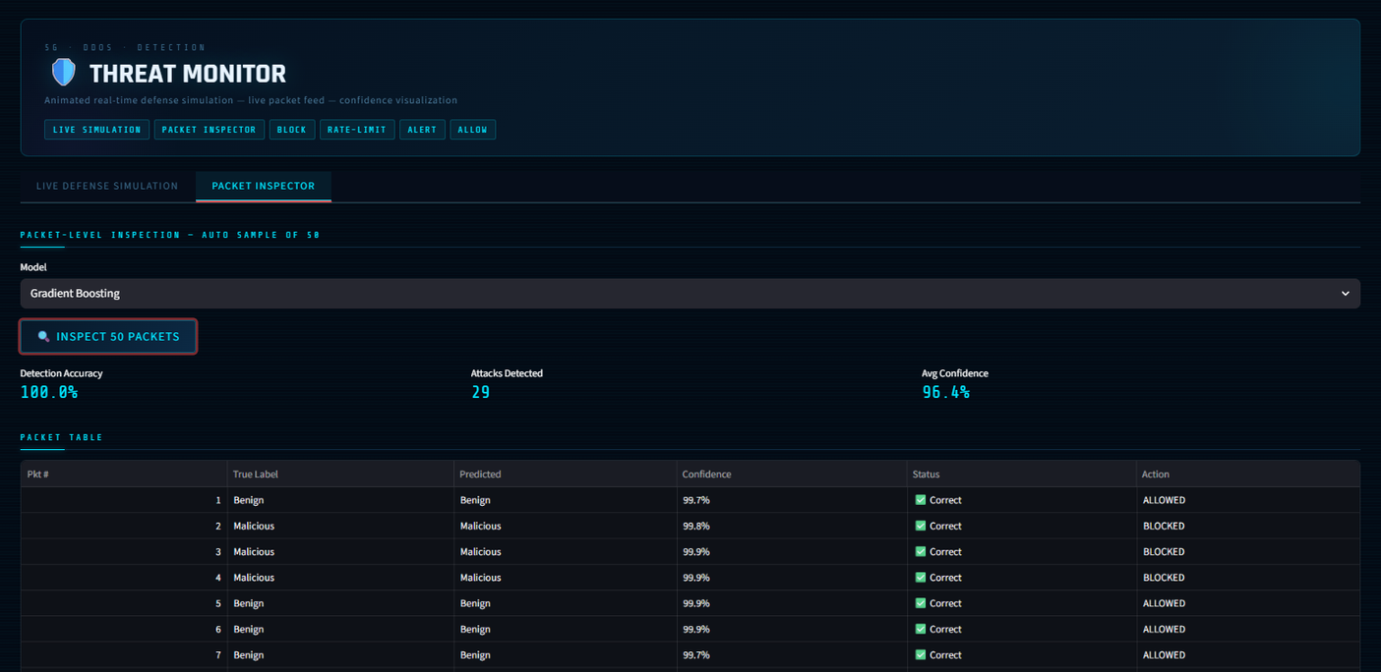
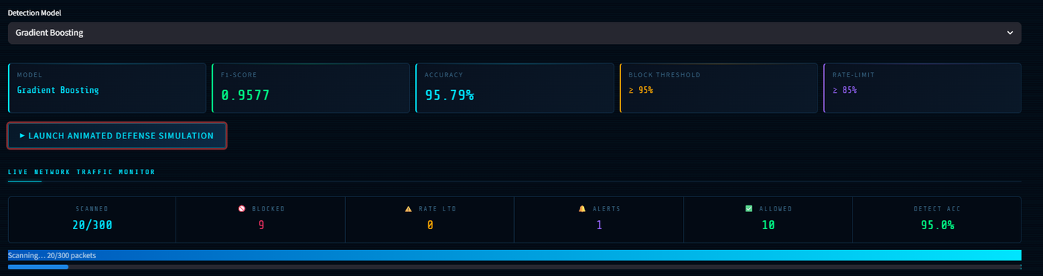
Real-Time Threat Monitoring
& Defense Simulation

Slide 13
Conclusion
The proposed system successfully demonstrates an intelligent, real-time DDoS detection and mitigation framework tailored for high-speed 5G networks. By integrating machine learning with interactive monitoring, the system addresses the limitations of traditional rule-based security mechanisms.
Key Outcomes
Developed a comprehensive threat monitoring framework with real-time capabilities
Implemented and evaluated multiple machine learning models for traffic classification
Achieved high detection accuracy and strong F1-scores, ensuring reliable performance
Enabled automated response mechanisms, including blocking, rate-limiting, and alert generation
Delivered an integrated dashboard for enhanced visibility and decision-making

Slide 14
Conclusion
Significance of the Work
The proposed solution addresses critical challenges in modern network security by:
Improving the speed and accuracy of attack detection
Supporting scalable and adaptive defense strategies
Reducing reliance on traditional signature-based systems
Limitations
Performance may be affected by previously unseen or evolving attack patterns
Minor challenges observed in real-time visualization handling
Further optimization required for deployment at large-scale network infrastructures
Future Scope
Incorporation of advanced deep learning techniques for improved detection
Deployment in cloud and edge computing environments
Integration with real-world 5G network systems
Development of adaptive and self-learning security mechanisms

Slide 15
Thank You

